Slide 1

Building AI Agents with LangChain and LangGraph
Discover how to combine LangChain and LangGraph. Create sophisticated AI assistants capable of complex conversations and tasks.

Slide 2
What is LangChain?
Framework
Tools
Ease of Use
It is for developing language model-powered applications.
It offers tools to enhance language models’ capabilities.
It enhances the ease of use of language models.

Slide 3

What is LangGraph?
1
Cyclic Computation
2
Extends LangChain
3
Agent-Like Behaviors
Adds cyclic computational capabilities to LLM applications.
Built on top of LangChain.
Enables complex, agent-like behaviors.

Slide 4

Key Concepts of LangGraph
Stateful Graph
Nodes
Each node represents a step in computation.
Building blocks representing functions or computation steps.
Edges
Connect nodes, defining the flow of computation.

Slide 5





Steps to Create a Graph
Define Graph State
Define the state structure for the graph.
Create the Graph
Create a new instance of StateGraph.
Define Nodes
Define nodes for classifying input.
Add Nodes to Graph
Add nodes and define the flow using edges.

Slide 6
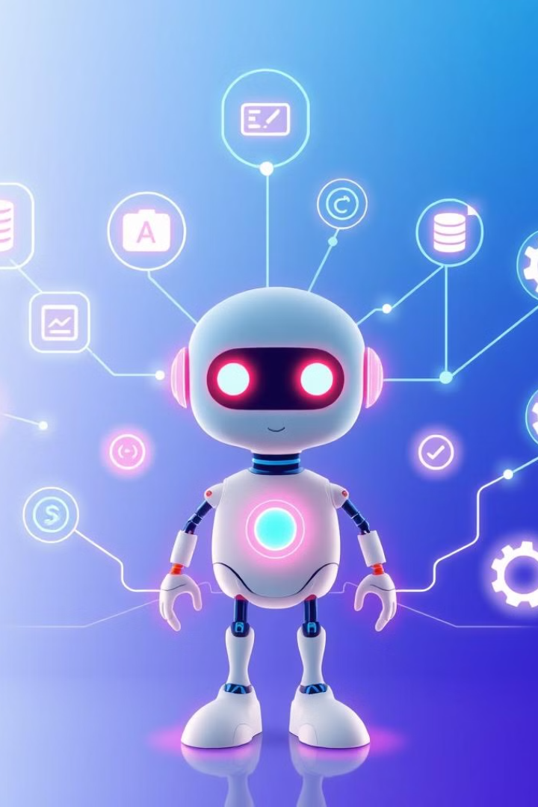



Tool Calling
Tool Calling
Flexibility
Agentic
Allows the LLM to interact with external systems.
Adds significant flexibility to the language model.
Makes the language model more agentic and capable.

Slide 7
Example Tool Definitions
Fetch Stock Price
Get Current Weather
Fetch the current stock price for a given symbol.
Get the current weather for a given location.

Slide 8

Conclusion
LangGraph is a versatile tool for building complex, stateful applications with LLMs.
Leverage its power for your projects by understanding its core concepts.

Slide 9

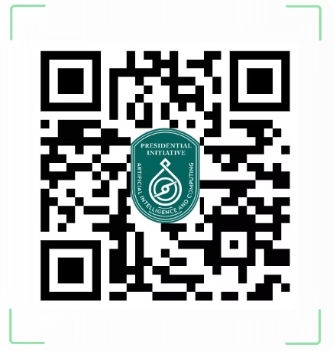
Presidential Initiative for Artificial Intelligence & Computing (PIAIC)
PIAIC aims to transform Pakistan through AI and cutting-edge technologies. The initiative seeks to establish Pakistan as a global hub for AI, cloud native computing, and related fields.

Slide 10
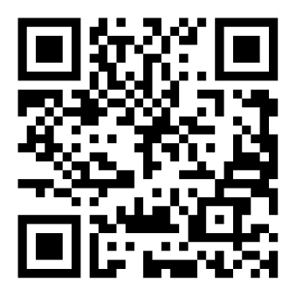
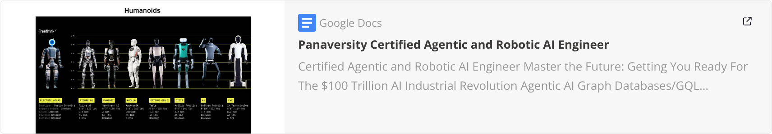
PIAIC Detailed Syllabus

Slide 11
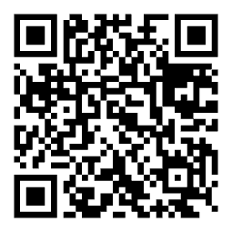
Stay Connected & Keep Learning!
🔗 Follow & Connect with Me: 📌 LinkedIn: linkedin.com/in/DevHammad0 📌 GitHub: github.com/DevHammad0
Scan the QR code to connect instantly!

